Slide 1

ABE 715
Computer Programming
Lecture 13: Machine Learning Basics
Predictive Modeling for Agriculture
Dr. Kadeghe G. Fue
Department of Agricultural Engineering
1

Slide 2
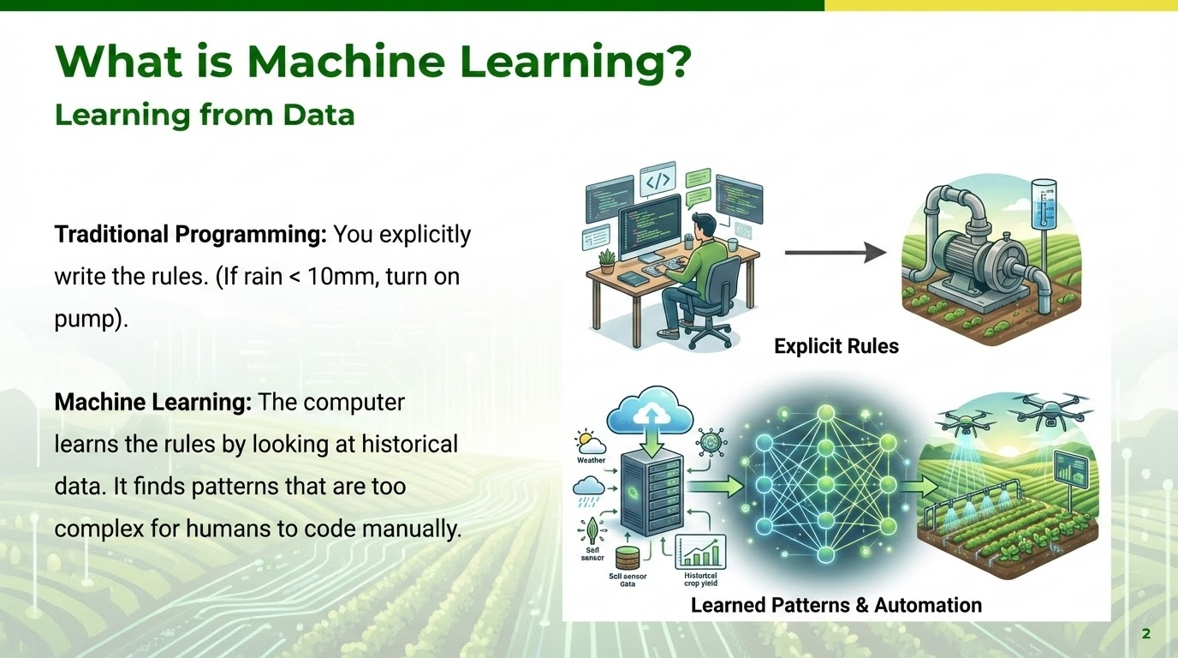

Slide 3





Types of Machine Learning
Supervised
Unsupervised
Reinforcement
The data has labels (Answers).
Input: Weather data, Output: Crop Yield.
No labels. The computer finds hidden structures.
Input: Soil samples -> Output: Soil Zones.
Learning by trial and error.
Input: Robot navigation in a field.
3

Slide 4
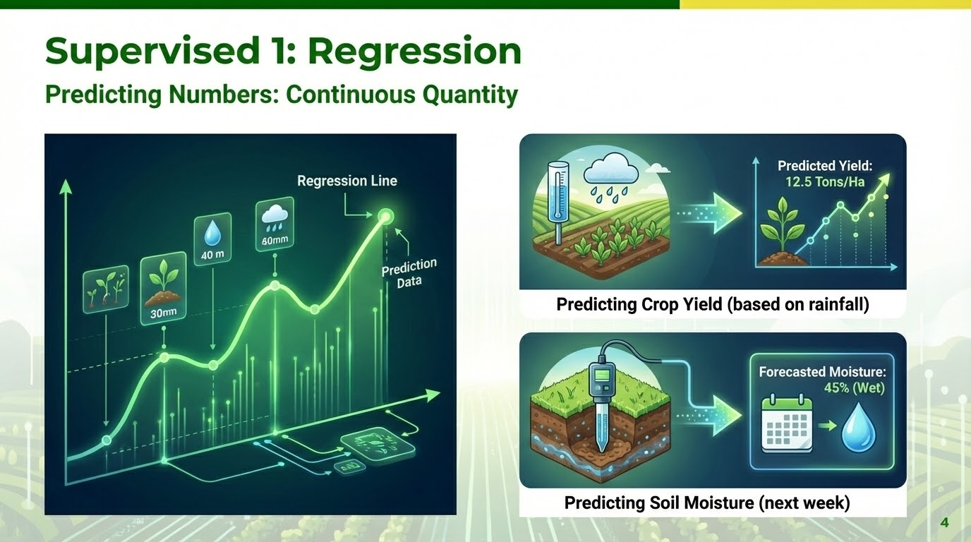

Slide 5
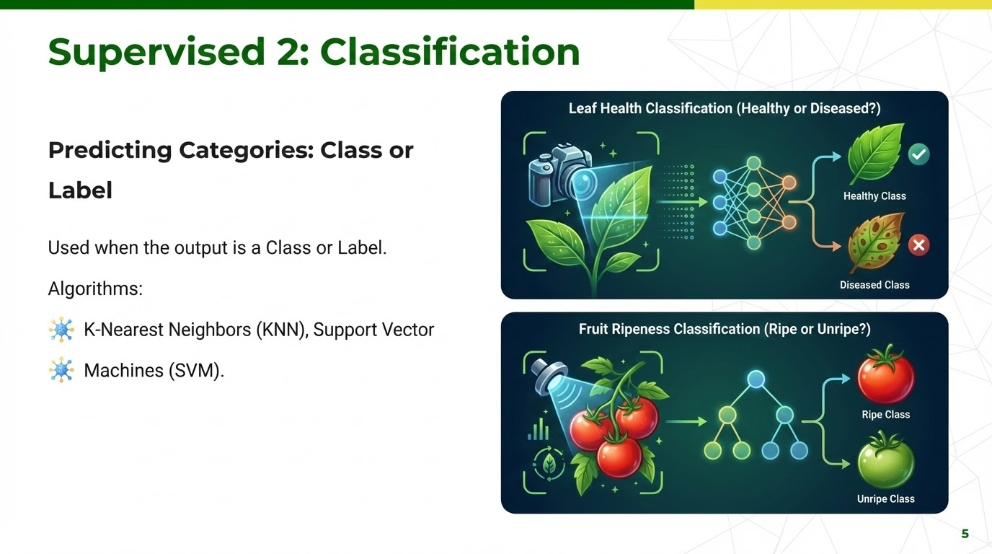

Slide 6
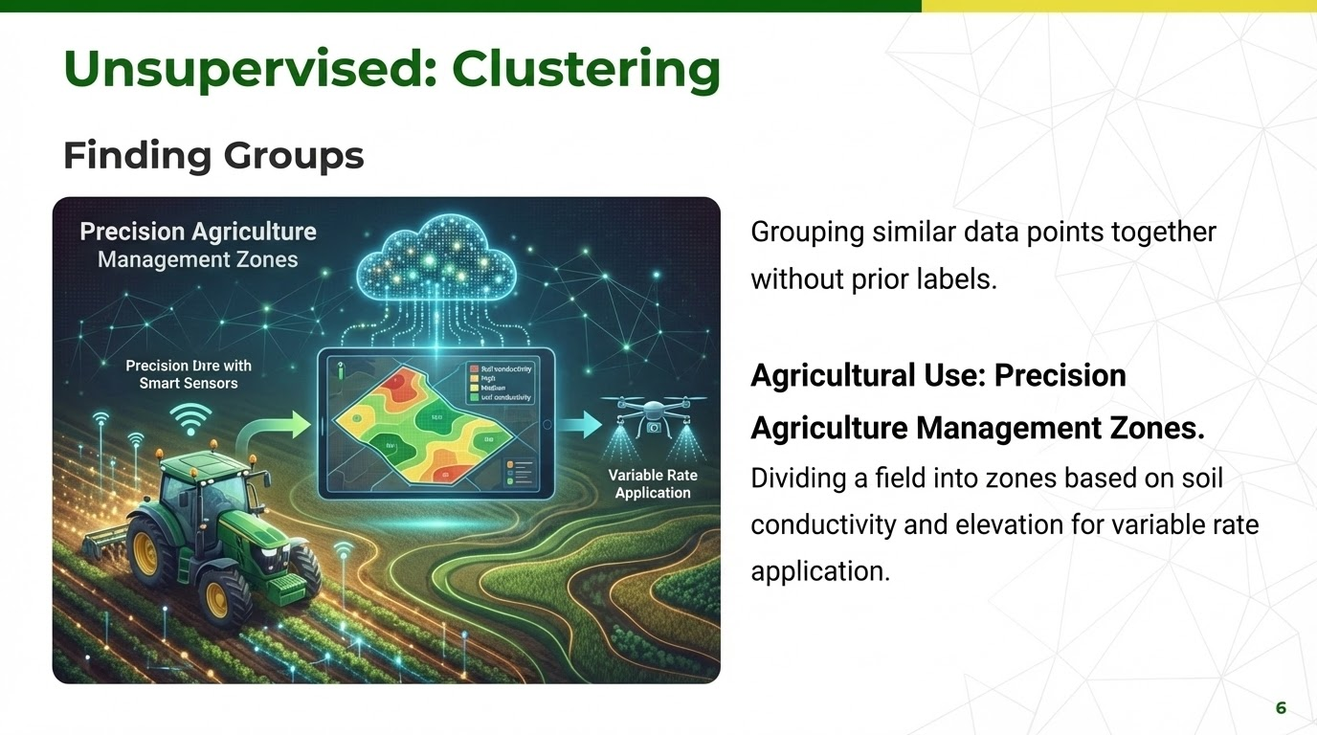

Slide 7
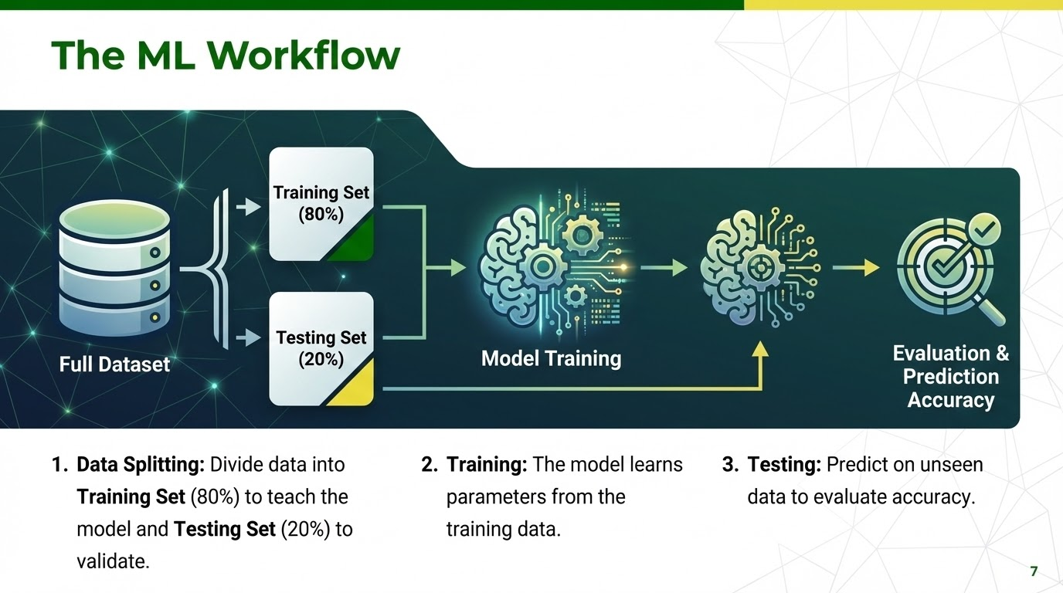

Slide 8
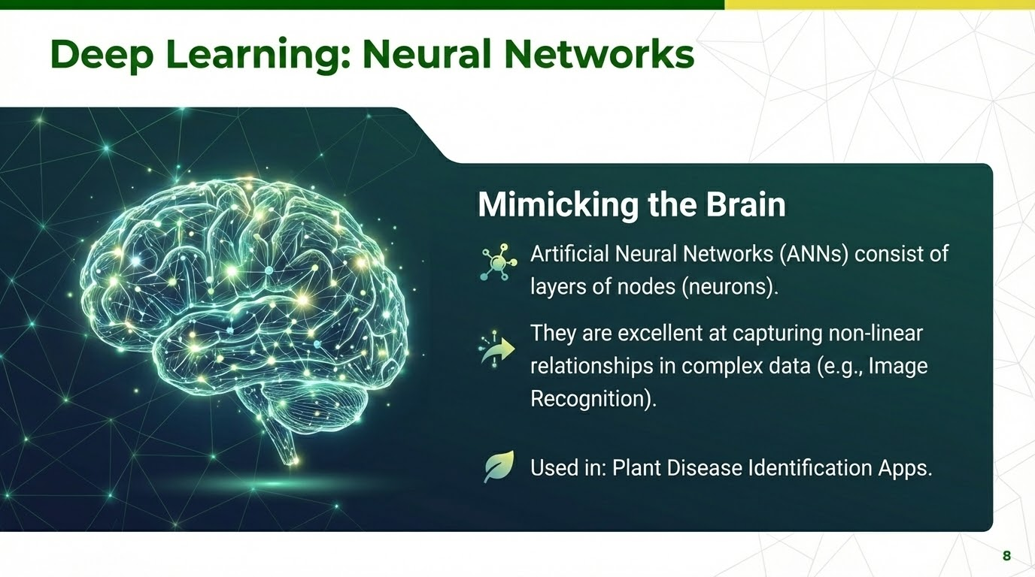

Slide 9
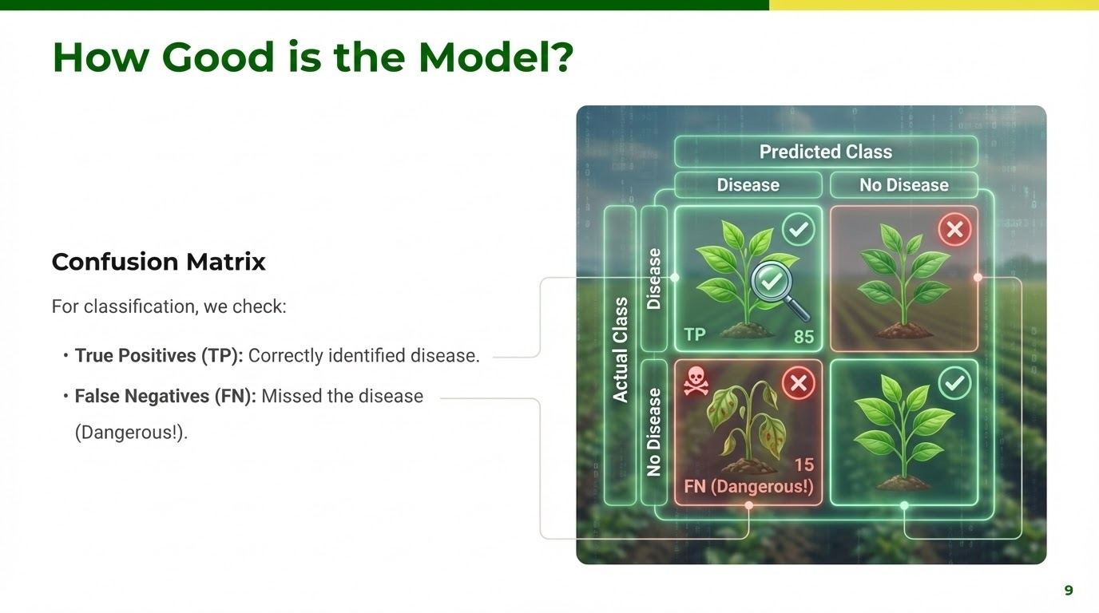

Slide 10
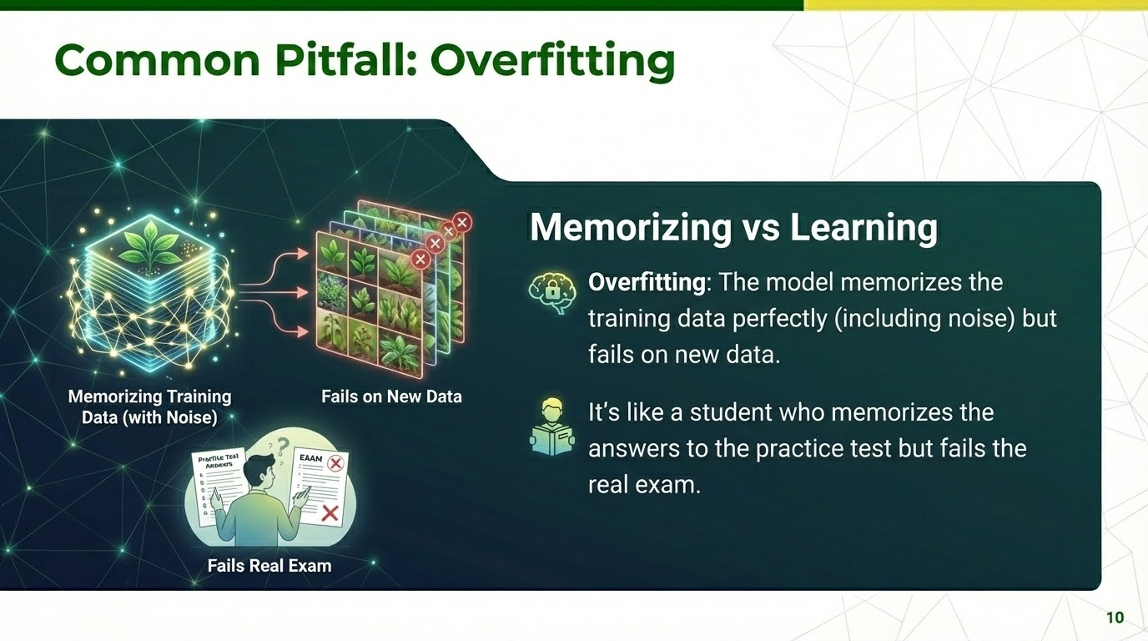

Slide 11





Challenges in Agriculture ML
Data Scarcity
Variability
Seasonality
Collecting high-quality agricultural data (e.g., destructive sampling) is expensive.
Biological systems are messy. Weather, pests, and soil variations add noise.
You often have to wait a whole year to get new training data for a specific crop stage.
11

Slide 12

Lecture 13: Take-Home Assignment
The Fertilizer Predictor
Scenario: You have a dataset of soil test results (N, P, K levels) and the optimal fertilizer amount applied.
Task:
1.
Create a dummy dataset in Python with 10 samples.
X = [[N1, P1, K1], ...], y = [Fertilizer_Amount, ...]
2.
Split the data into Training (8 samples) and Testing (2 samples).
3.
Train a Linear Regression model using sklearn.
4.
Predict the fertilizer needed for a new soil sample: N=40, P=20, K=30.
12

Slide 13
Questions?
Next Class: Internet of Things (IoT) Integration
Dr. Kadeghe G. Fue
Department of Agricultural Engineering
13

